Slide 1
Finite State Machine
Osama Hussain

Slide 2
Content
Concept
Mealy & Moore Machines
UML State Machines
UML State Diagrams
Examples
Implementation

Slide 3
Concept
A finite state machine (hereinafter called FSM) is a mathematical model which abstracts the representation of behavior exhibited by some systems

Slide 4
Mathematical Model
Check it by yourself ☺

Slide 5
System & Behavior
System
System
Abstraction
Behavior
FSM
System
…

Slide 6
Examples
Traffic Light
Switching lights on and off
Text Parsers
Detection of certain phrase or word
Washing Machine
Washing, Rinsing, Spinning …
Mario in Super Mario Game
Walk, Run, Jump …

Slide 7
Remarks
Not all systems can be modeled in FSM
Real-time systems for example
Memory limitations due to huge number of states
Not all systems can be easily modeled in FSM
Some behaviors are hard to describe in terms of states
Proper FSM design can lead to easier system development

Slide 8
Within Game Dev.
Some Game Developers think
FSM is only considered for AI field
FSM is only used in abstracting character behavior
FSM is only considered for Gameplay Programmers

Slide 9
Misconception
Some Game Developers think
FSM is only considered for AI field
FSM is only used in abstracting character behavior
FSM is only considered for Gameplay Programmers
☺

Slide 10

Composition
FSM consists of several states
In Programming, state is a technical term for all the stored information, at a given point in time, which the program has access to.
Spinning in Washing Machine
C++ parser detects “int” keyword CPP file
Mario Jumping inside a Super Mario game
Red Light in Traffic Light

Slide 11

Composition
Inputs into the machine are combined with the current state of the machine to determine the new state or the next state of the machine
Current State
Next State
Input

Slide 12
State diagram
Donate a graphical representation of an FSM
UML State diagrams

Slide 13
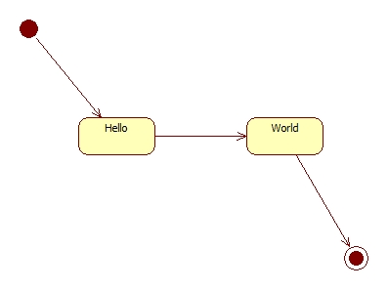
“Hello World” state diagram
Initial Transition
States
Indicator of Initial Transition
Final State
Transitions
Initial State

Slide 14
Composition
Output … ?

Slide 15
Mealy Machine
Output determined by state and input

Slide 16
Traffic Light – Concept
We got 3 lights that can be switched on and off individually, they are: Red, Yellow, and Green
Traffic light contains a timer
The traffic light starts by turning on the red light and turn off the rest
After timer completes, switch on the green light and turn off the rest
After timer completes, switch on the yellow light and turn off the rest
After timer completes, switch on the red light and turn off the rest
Restart again

Slide 17
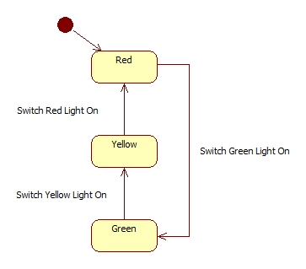
Traffic Light – Mealy Machine

Slide 18
Quote Parser – Concept
For a whole string of characters, print characters which are within double quotations
Example
Input: “Hello ”people, what a nice “world!”
Output: Hello world!

Slide 19
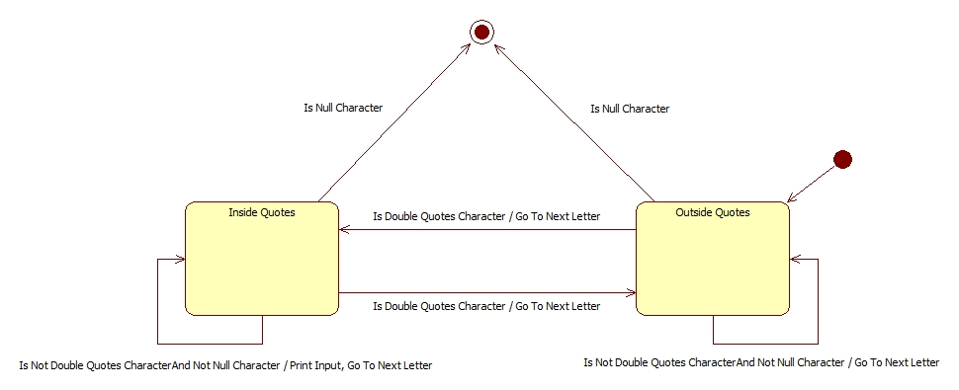
Quote Parser – Mealy Machine

Slide 20
Moore Machine
Output determined by state and output

Slide 21
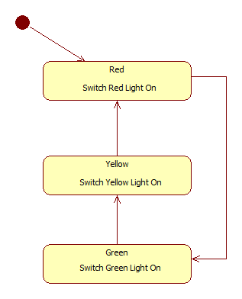
Traffic Light – Moore Machine

Slide 22
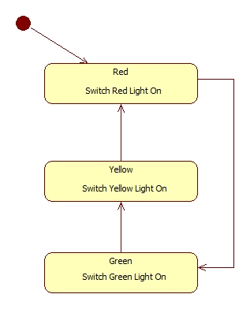
Traffic Light - Comparison
Mealy Machine
Moore Machine

Slide 23
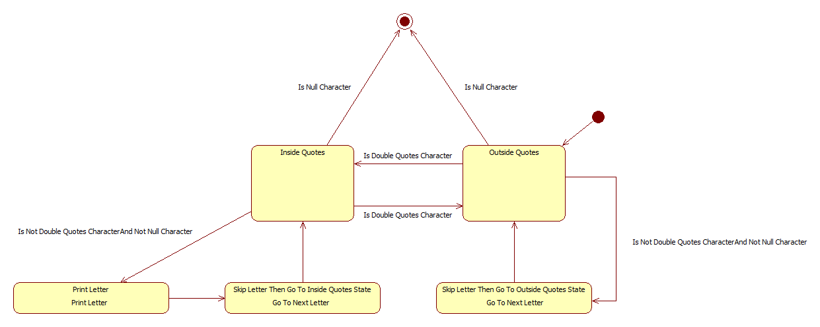
Quote Parser – Moore Machine

Slide 24
UML State Machine
Significantly enhanced realization of the mathematical concept of a finite automaton in Computer Science applications as expressed in the Unified Modeling Language notation
Object-based variant of Harel statechart (the concept of nested states)
Combines both Mealy and Moore machines with further addition of features

Slide 25
State Structure
Think of your states as objects where you might need to
Initialize it through Entry actions
Update it through Do actions
Finalize it through Exit actions

Slide 26
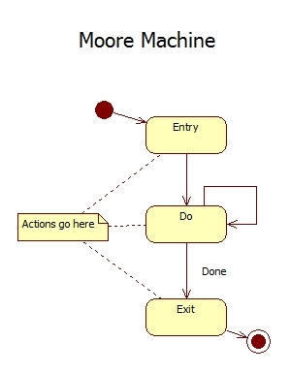
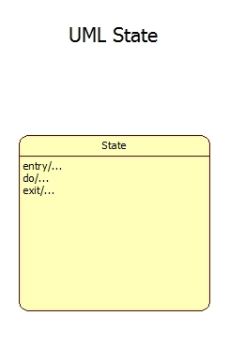
State Structure

Slide 27
Advantages
Less states
Default control mechanism
Object oriented style

Slide 28
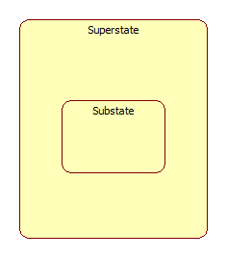
Hierarchically Nested States
Arranging states in a structural way

Slide 29
Hierarchically Nested States
The most important innovation of UML state machines over the traditional FSMs
State nesting is not limited to one level only
TOP state
Exist in every state machine
Contains all the other elements of the entire state machine
Optionally to depict it in the diagram

Slide 30
Traffic Light
Based on previous traffic light description
Add to that a switch
You can turn the traffic light on and off at any time
If the traffic light is switched on, then it operates normally
Otherwise, all the lights will be turned off
By default the traffic light is turned off

Slide 31
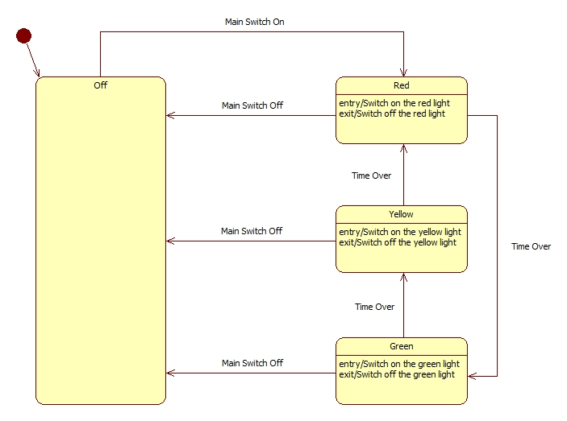
Traffic Light

Slide 32
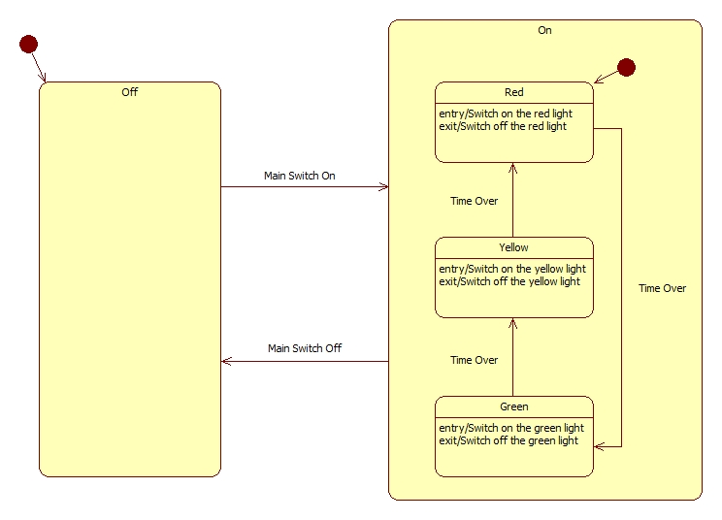
Traffic Light

Slide 33
Gain
Less transitions
Less states
Structural behavior
Zoom out: Hide complexity of the system
Zoom in: View the details of sub behavior in meaningful way

Slide 34
History
A facility to return back to the previous state

Slide 35
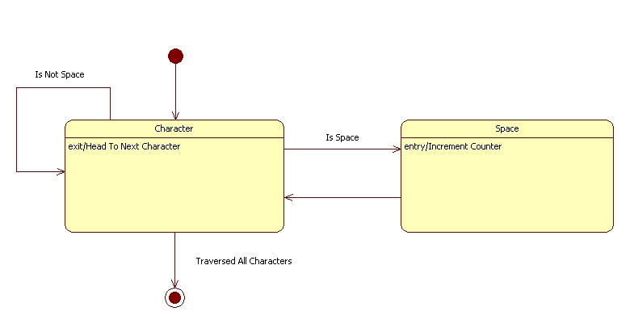
Space Counter

Slide 36
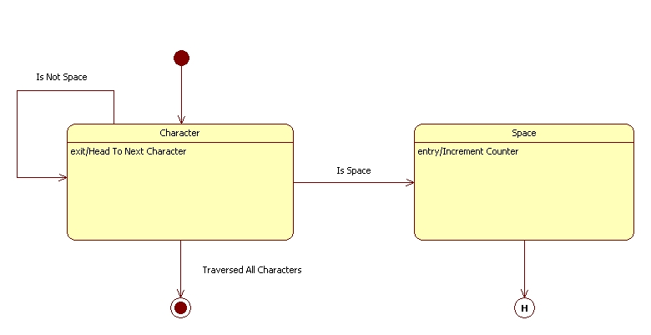
Space Counter

Slide 37
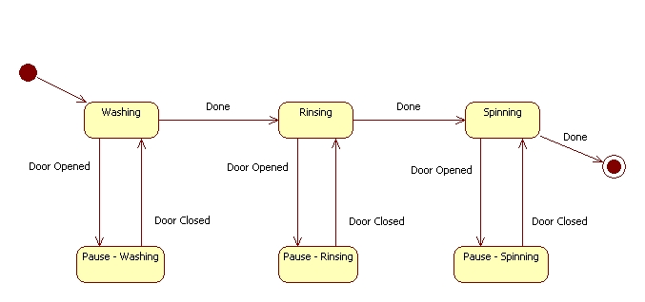
Washing Machine

Slide 38
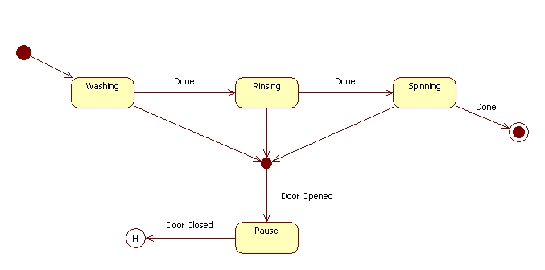
Washing Machine
Junction Point
A.K.A. Shallow History

Slide 39
Deep History
Recall the state of every nested substate of the enclosing substate, down to any level of nesting

Slide 40
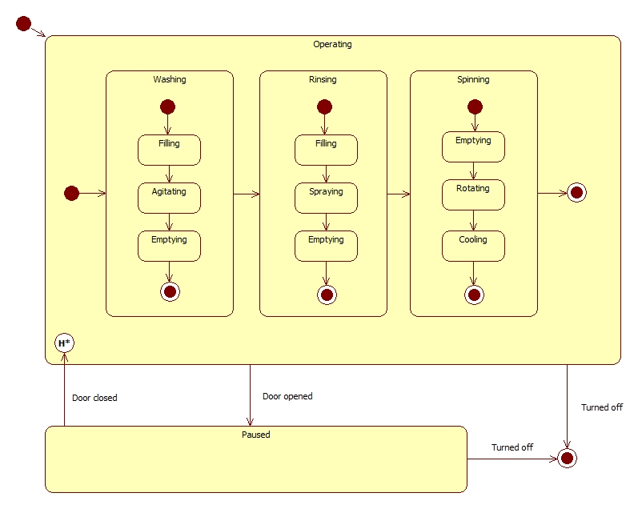
Washing Machine

Slide 41
Orthogonal Regions
A state can contain two or more independent regions runs concurrently

Slide 42
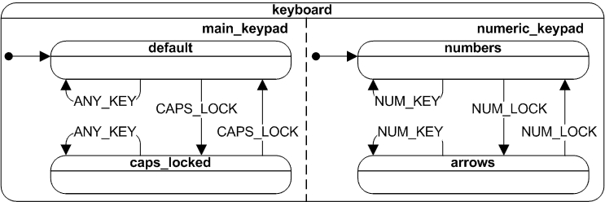
Keyboard

Slide 43
Counter
Imagine designing a FSM for 32-bit counter
Input: an external trigger
Output: once reaches 2^32 – 1, the system peeps!
More than 4 billion different states!

Slide 45
Extended states
State machines supplemented with variables

Slide 46
Extended states
Program variables are commonly dissociated from states
the complete condition of the system (called the extended state) is the combination of a qualitative aspect (the state) and the quantitative aspects (the extended state variables)
UML state machines belong to this category

Slide 47
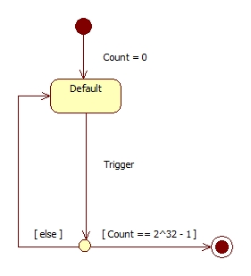
Counter
Guard Conditions
Choice Point

Slide 48
Guard Conditions
Boolean expressions evaluated dynamically based on the value of extended state variables and event parameters
Enable actions or transitions only when they evaluate to TRUE and disabling them when they evaluate to FALSE
Shown in square brackets “[]”

Slide 49
Guard Conditions
Good for the design, making it further simpler
However, do not use it to eliminate states that you actually start used to eliminate IF ELSE statements!
If you do … spaghetti code

Slide 50
State Diagrams' Limitations
Any nontrivial state machine requires a large amount of textual information. For example, actions
Depend heavily on the specific programming language
Poorly represent the sequence of processing
Require a lot of plumbing gear (junction points, choice points, etc.) to represent the flow of control graphically
several complementary views of the same state machine

Slide 51
Commercial Tools
Rational Rose
Well known tool
Bought by IBM in 2003
Bouml
Cross-platform
Was free at certain point of time ☹

Slide 52
Open Source Tools
StarUML
Windows only
Have most of the features required for State diagrams with only exception of orthogonal regions
No longer being in development ☹
Many initiatives to re-launch the project again

Slide 53
Questions?

Slide 54
Thank you

